Slide 1

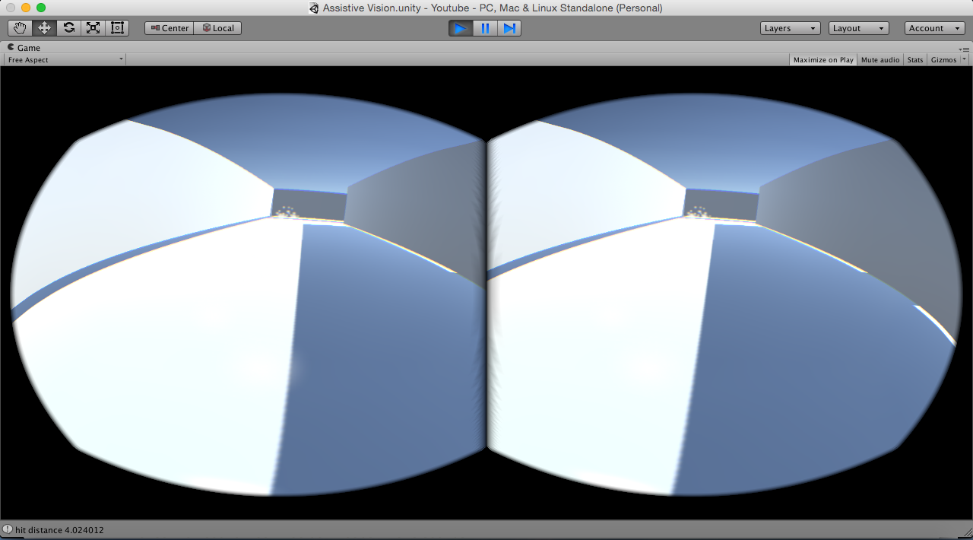
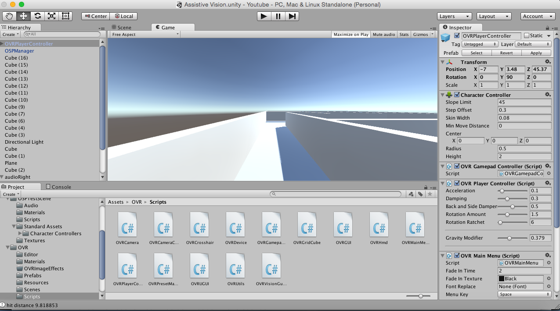
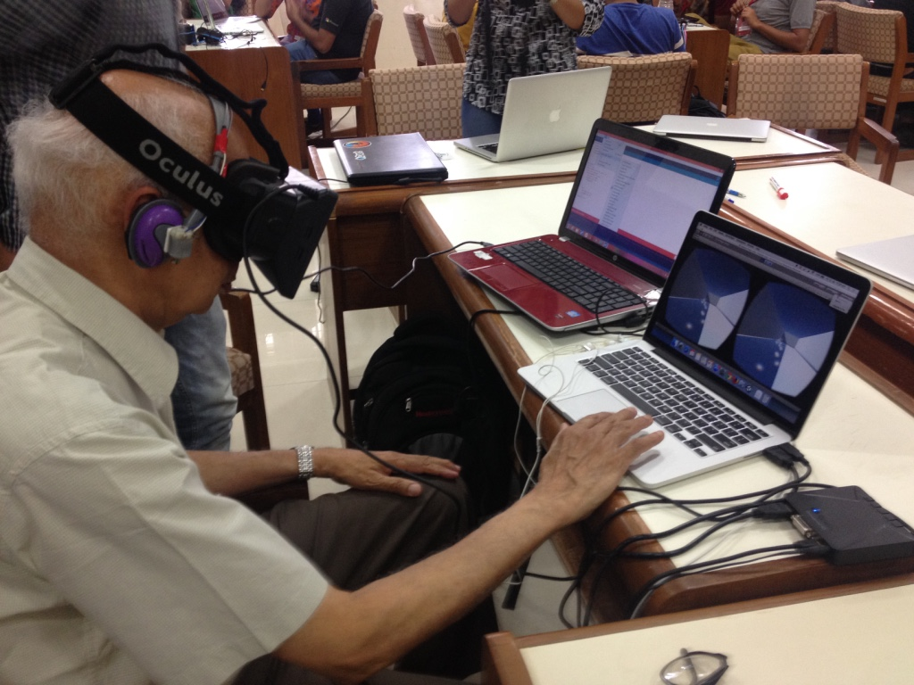
Assistive Vision Simulator
Tristan Swedish, Mrinal Mohit, Tushar Kamath, Anandan Waghmare, Vinay Chandragiri,Devendra Dora, Rishabh Jangir, Avijit Dasgupta,Tarun Sharma, Akilan G, Richa Nagda, Shikha Suneja, Ramesh Raskar
Problem Statement
Potential Impact
The goal is to design and develop a head mounted device with auditory and haptic feedback, to help Visually Impaired patients to navigate without help from any other external tools. We developed the Assistive Vision Simulator as a means to better understand and identify the modalities that can substitute for visual information. This can be achieved from the response obtained from testing the simulator over people with a range of different eye sight.
Individuals with visual impairment or blindness find it difficult to self navigate that makes them dependent on external tools or a caregiver. The Assistive Vision Simulator is designed to assess the best technologies that will allow these individuals to navigate more independently.
Highlights
A view from the oculus.
The simulating environment designed in Unity.
Dr.Balasubramaniam using the simulator.
Results and Future Work
The result of this week’s work is a simulator for the head mounted device. We tested the simulator on few individuals, including visually impaired people, and their response was positive and encouraging. The future work includes designing and developing the product by using the feedback obtained. This is an iterative process which will eventually lead to the final head mounted product which will help the visually impaired to navigate.

